Slide 1

Healthcare – Persistency of Drug
Model selection and Model building
Group Name: The Insights Team
29th May 2024

Slide 2
Team Members
S/N | Name | Email | Country | College | Specialization
1 | Tomisin Abimbola Adeniyi | tomisin_adeniyi11@yahoo.com | Nigeria |  | Data Science
2 | Fabio Pontecchiani | pontecchianifabio@gmail.com | Belgium | University of Sheffield | Data Science
3 | Bilikis Omolara Alayo | berlykis@gmail.com | United Kingdom |  | Data Science

Slide 3
Background
Typically, the continuance of action or efficacy of a drug within the body is referred to as its "persistency of drug." It indicates how long a substance is present or active in the body following administration. This concept is crucial in the fields of pharmacology and medicine, as it facilitates the determination of treatment regimens, prescription schedules, and potential adverse effects of medications. Substances that possess high persistency may necessitate less frequent dosing, whereas those that possess low persistency may demand more frequent administration to sustain therapeutic concentrations within the organism.

Slide 4
Problem Description
Accurately determining the duration of medication use as advised by doctors presents a substantial difficulty for pharmaceutical companies. This makes it more difficult to understand patient adherence trends and optimise treatment outcomes. To tackle this problem, ABC Pharma Company seeks to create an automated system that tracks and identifies drug persistency based on doctor prescriptions.

Slide 5
Key Objectives
Insights Gathering: We aim to gather some insights and increase our knowledge of factors impacting drug persistence by exploring the provided dataset.
Model Building: Develop a classification model to predict the Persistency-Flag, leading to better decisions and targeted interventions that benefit patients and make the most efficient use of pharmaceutical resources.

Slide 6
Data Analysis Approach
The data analysis approach will be carried out as follows:
Data Exploration
Features Analysis
Data Cleaning and Transformation
Recommendation for the proposed classification model

Slide 7
Data Exploration
Datasets details
The dataset analysed in this study is called “Healthcare_dataset.xlsx”
It contains:
3424 data points
69 Features (67 categorical and 2 numerical features)
Issues in the dataset
During the exploration, the following issues were detected in the dataset:
Missing values – The dataset contains a substantial number of missing values from 8 categorical features
Outliers – The numerical variables contain outliers.
Skewness - The numerical variables in the dataset are right skewed
Imbalance in the target class “Persistency_Flag”

Slide 8
Features Analysis
The features the in dataset were grouped in the following categories:
Demographics
• Age
• Race
• Region
• Ethnicity
• Gender
• IDN Indicator
Clinical Factors
• NTM - T_Score
• NTM - Risk Segment
• NTM - Dexa Scan Frequency
• Dexa During Therapy
• NTM - Fragility Fracture Recency
• Fragility Fracture During Therapy
• NTM - Glucocorticoid Recency
• Glucocorticoid Usage During Therapy
Disease/ Treatment Factors
• NTM - Injectable Experience
• NTM - Risk Factors
• NTM - Comorbidity
• NTM - Concomitancy
• Adherence
Provider Attributes
• NTM Physician specialist
• Physician Specialist flag
• Physician Specialist bucket

Slide 9
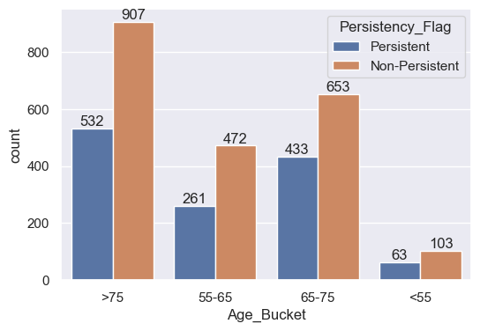
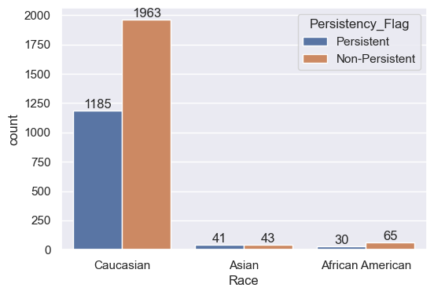
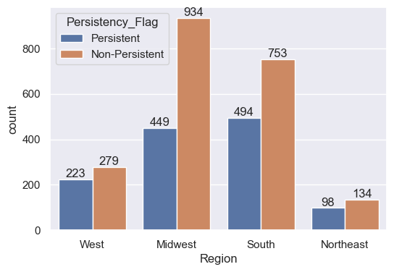
Features Analysis – (categorical features)
The following plots show the analysis of some categorical features (‘Age Bucket’, ‘Race’ and ‘Region’) against the target class – Persistency Flag:
Fig 1: Class analysis by Age Bucket
Fig 2: Class analysis by Race
Fig 3: Class analysis by Region
Majority of the patients with persistence during the therapy are above 65 years old.
Majority of the race with high persistency are Caucasians.
Patients from the South and Midwest regions have the highest persistence.

Slide 10
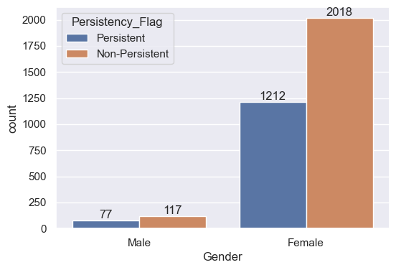
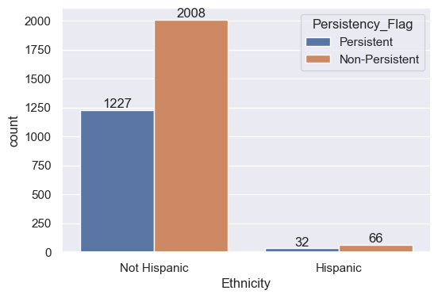
Features Analysis – (categorical features)
The following plots show the analysis of categorical features (‘Age Bucket’, ‘Race’ and ‘Region’) against the target variable – Persistency Flag:
Fig 4: Class analysis by Gender
Fig 5: Class analysis by Ethnicity
The female genders have a high persistence compared to their male counterparts.
Patients of non-Hispanic origin have the highest proportion of persistence.

Slide 11
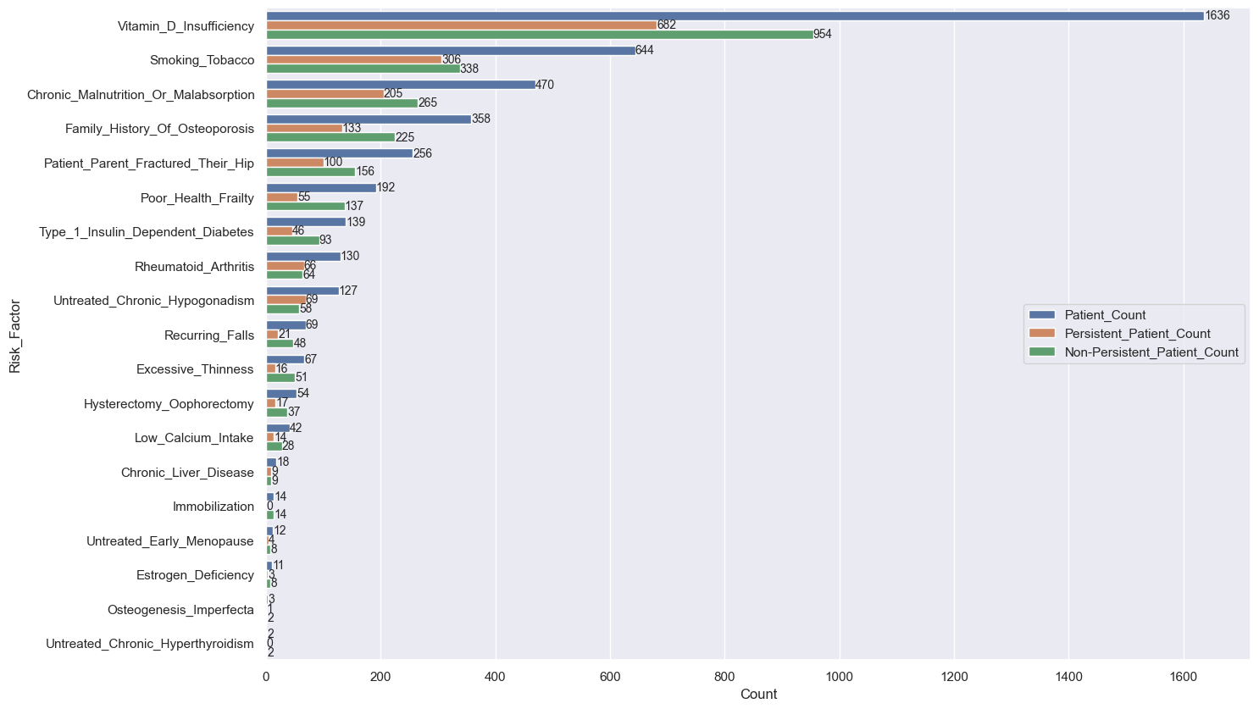
Features Analysis – (categorical features)
The following plot shows the analysis of categorical features under Risk Factors against the target variable – Persistency Flag:
Fig 6: Risk _Factors analysis by target class
The number of patients suffering Vitamin-D sufficiency is extremely higher than other risk factors.
Most patients with the risk factors are non-persistent with the NTM treatment.

Slide 12
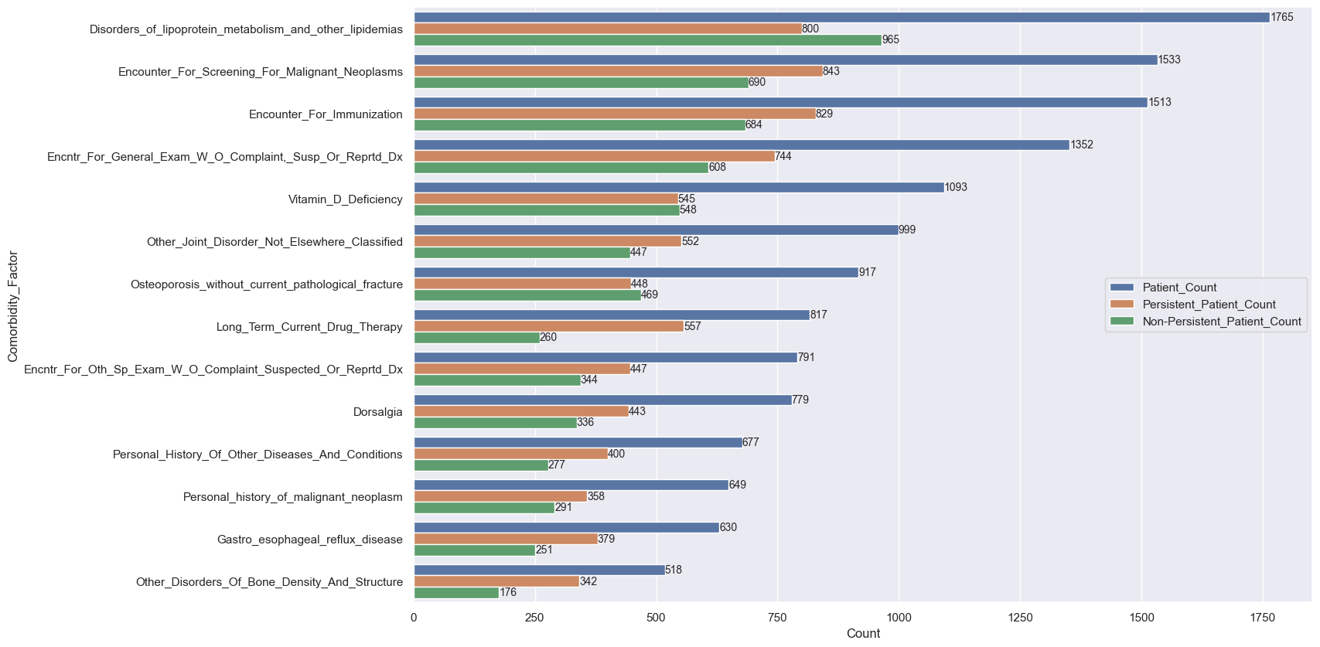
Features Analysis – (categorical features)
The following plot shows the analysis of categorical features under Comorbidity factors against the target variable – Persistency Flag:
Fig 7: Comorbidity factors analysis by target class
Most patients either suffer a disorder or encounter for screening related to Lipidemia, Malignant Neoplasms, or Immunization.
Most patients (11 out of 14) with comorbidity factors are persistent with the NTM treatment.

Slide 13
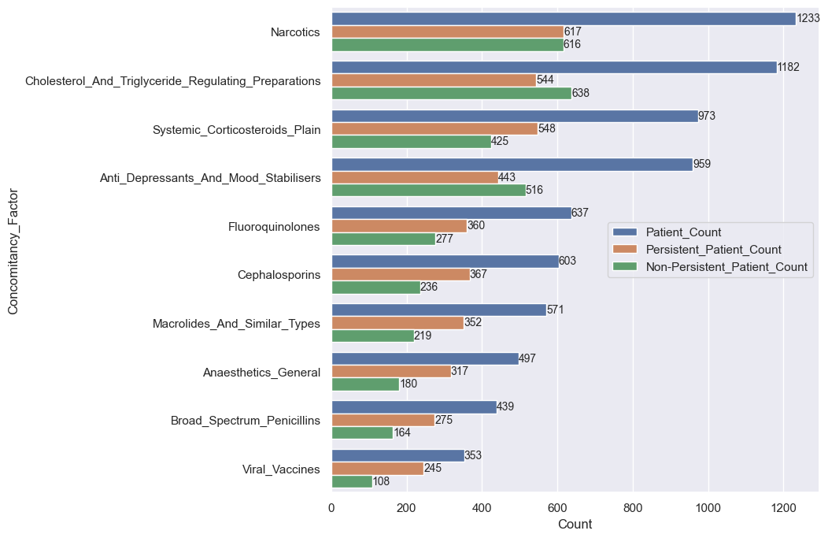
Features Analysis – (categorical features)
The following plot shows the analysis of categorical features under Concomitancy factors against the target variable – Persistency Flag.
Fig 8: Concomitancy factors analysis by target class
The most prevalent concomitant drugs recorded are Narcotics, Cholesterol and Triglyceride regulating preparations, Systemic Corticosteroids plain, and Anti-depressants and Mood-stabilizers
Most patients on concomitant drugs are persistent with NTM therapy

Slide 14
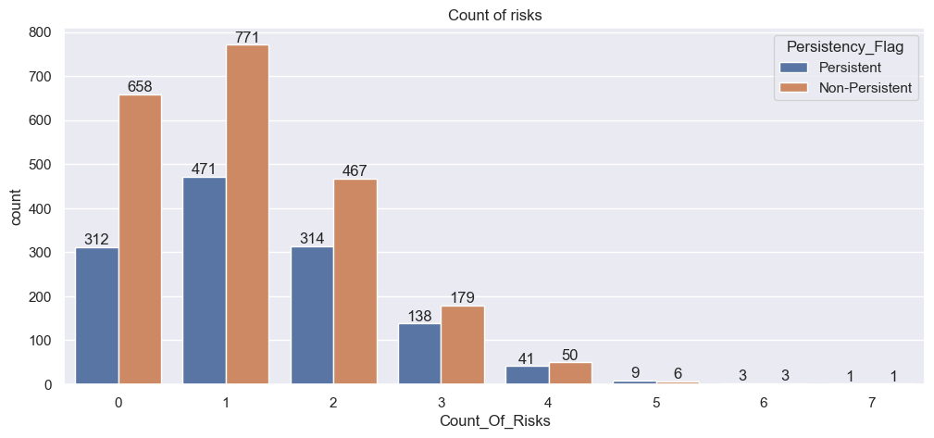
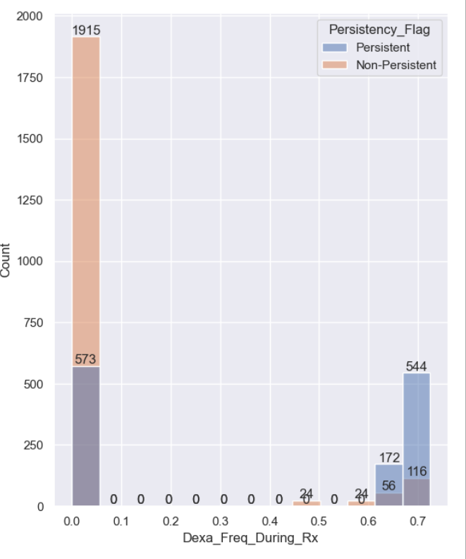
Features Analysis – (Numerical features)
The dataset contains two numerical features which Dexa-scan frequency during therapy and the Count of Risks. These features are rightly skewed and contain some outliers.
Fig 9: Count of Risks analysis by target class
Fig 10: Dexa-scan frequency during therapy analysis by target class
Most of the persistency-Flag of Count of Risks lies between 0 and 2.
The highest persistency-Flag frequency count to Dexa-scan frequency during therapy is 7 while the least is 0

Slide 15
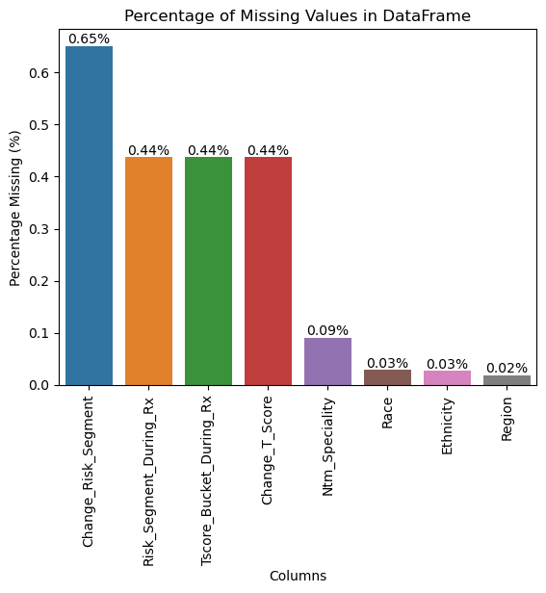
Data cleaning and transformation
The data cleaning and transformation done on the dataset entails the following:
Missing Values
The dataset contains a substantial number of missing values from 8 categorical features, and this was handled by applying two methods viz: mean imputation and model-based imputation.
Since the missing values were categorical, mode imputation was eventually adopted as a single imputation method for addressing the missingness. The mode imputation method appears suitable as it is straightforward and does not require categorical label encoding while the model-based imputation does require label encoding.
Fig 11: Proportion of missing values in the dataset

Slide 16
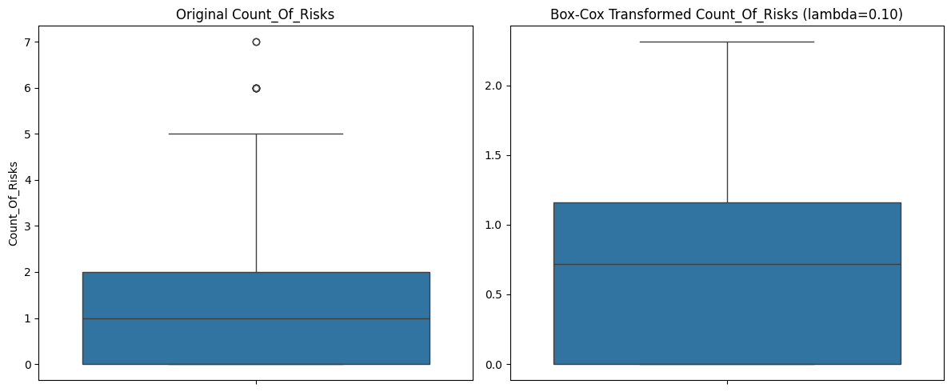
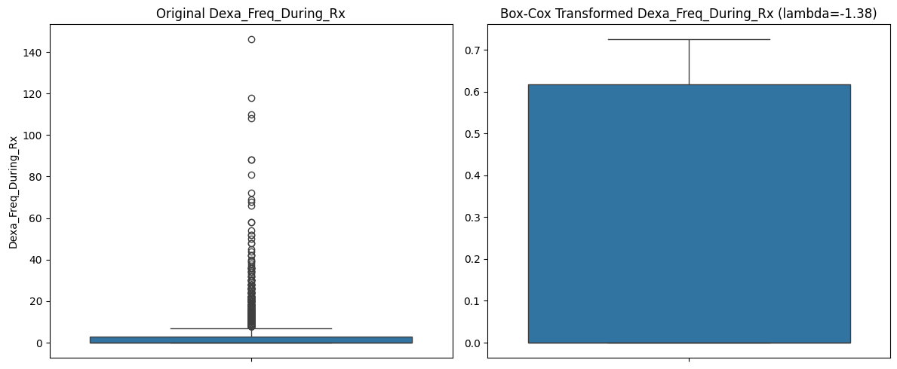
Data cleaning and transformation (cont’d)
Outlier
Outliers in the numerical variables of the dataset were handled using the Box-Cox transformation. The Count of Risks feature was transformed using an estimated lambda function of 0.09947523122712457, while the Dexa-scan frequency during therapy feature was modified using an estimated lambda function of 1.3784802096724922.
Fig 12: Count of Risks feature before and after transformation
Fig 13: Dexa-scan frequency during therapy feature before and after transformation

Slide 17

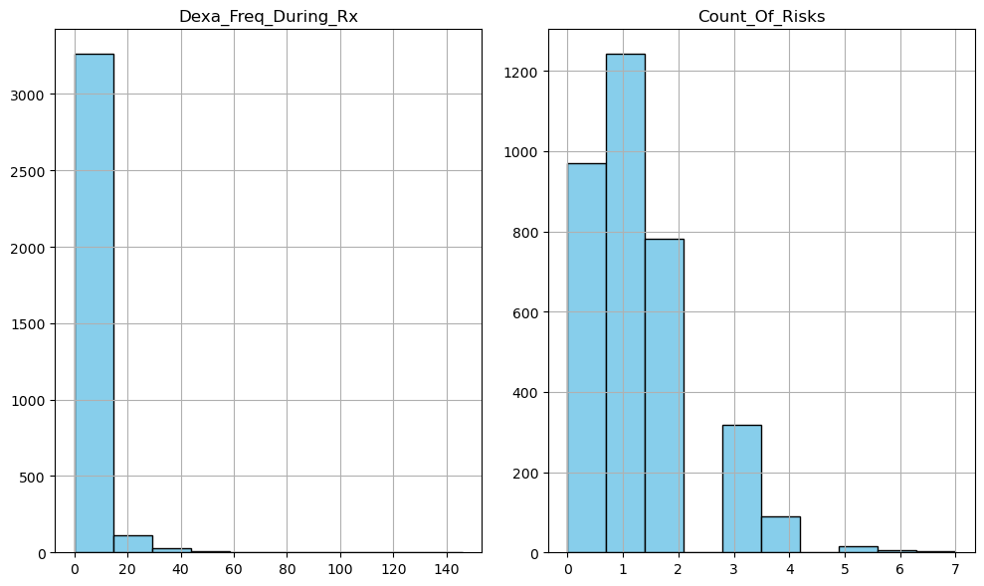
Data cleaning and transformation (cont’d)
Skewness
Fig 14: Histogram representation of numerical features
The Dexa-scan frequency during therapy feature exhibits a highly right-skewed distribution, with most data points on the left side and a long tail towards the right, indicating a few high-value data points that could significantly impact the mean and analysis.
Similarly, the Count of Risks data exhibits a moderately right-skewed distribution, with a slight trend towards higher values and a moderate number of data points exceeding the mean.

Slide 18
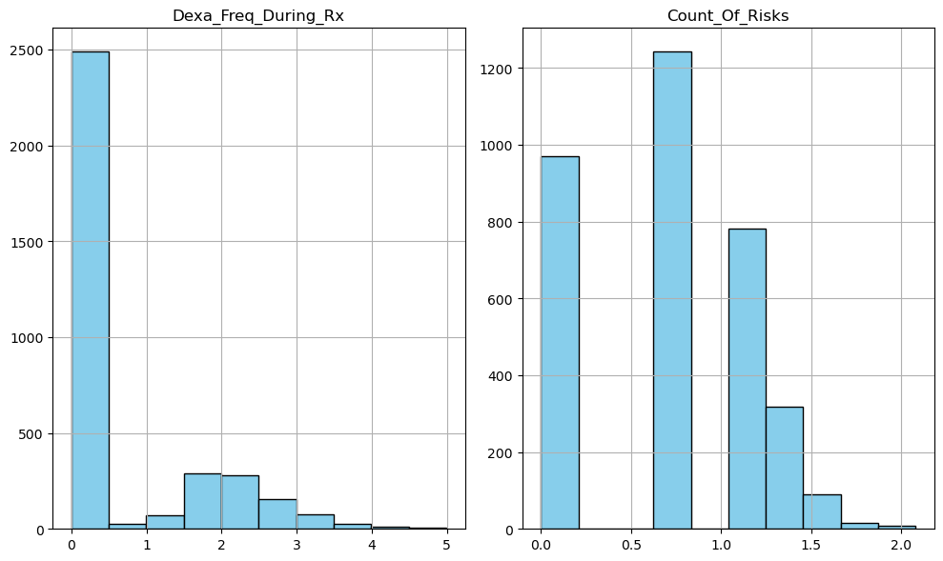
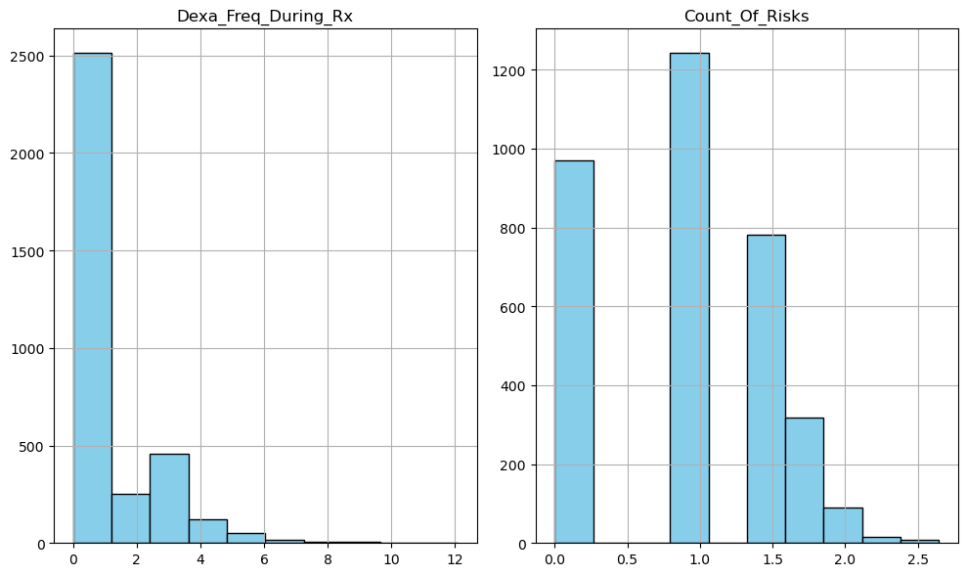


Data cleaning and transformation (cont’d)
By independently implementing the log and square root transformations, the skewness in the numerical variables was effectively reduced.
Fig 15: Skewness before and after implementing log transformation
on numerical features
Fig 16: Skewness before and after implementing square root transformation
on numerical features
Log transformation appears to have a significantly reduced skewness when applied to the numerical features compared to the other method used to manage skewness. The log transformation procedure is therefore implemented to address the skewness of the numerical features.

Slide 19
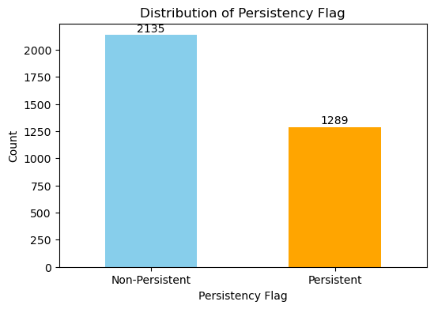
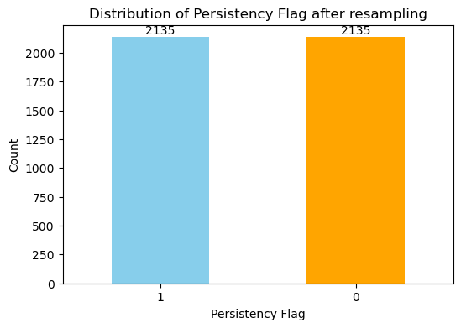
Data cleaning and transformation (cont’d)
Class imbalance
The imbalance discovered in the target variable (`Persistency_Flag`) is handled using the Synthetic oversampling techniques (SMOTE) as it creates synthetic samples that are typical of the minority class, which improves the model's capacity to generalise to previously unknown data. Also, it can reduce overfitting caused by merely replicating minority class data. The feature was encoded before applying SMOTE.
Fig 17: Target class distribution showing class imbalance
Fig 18: Target class distribution after transformation and balancing

Slide 20
Feature correlations and Selection
The two numerical features have a positive correlation with the target class, but Dexa-scan frequency during therapy has a higher correlation coefficient compared to Count of Risk.
.
Also, some of the categorical features under Risk factors have low negative correlation coefficients and these features would not be selected for modeling.
The methods of feature selection (mutual information and model-based) applied selected different numbers of features based on the logic behind each method. However, some of these features were commonly selected by these methods. Therefore, Race, Ethnicity, Region and a few of the Risk categories will be dropped as these methods did not select them, and they have a much lower correlation coefficient with the target class.

Slide 21
EDA Summary
From the analysis:
Most of the physicians are not specialists.
Most of the patients are mapped to IDN
Most of the patients are female (around 15 times more females)
Majority the patients are not Hispanic (20 times more not Hispanic)
Most of the patients are from the Midwest and South regions.
Majority of the patients are Caucasians.
Majority of the patients during the therapy are above 65 years old
The numerical features have positive correlations with the target class.
The missing values in the dataset were handled using mode imputation
Outliers were addressed using Box-Cox transformation
Skewness handles by log transformation
Class imbalance addressed using the SMOTE techniques
Some categorical features like Race, Ethnicity, Region, and some Risk factors features will not be included in the model.
.

Slide 22
Model Recommendations
To develop a classification model to predict the Persistency Flag, the following model may be used:
Logistic Regression
It is a linear model that is easy to implement and interpret. It is used for the binary classification of
categorical dependent variables, like the case of the target class in this study.
Random Forest
This is an ensemble learning method that builds on a large number of decision trees during training and
outputs the mode of the classes for a classification problem. It offers, with minimal tuning, a strong, high-
accuracy model. It manages big datasets effectively and lowers overfitting by averaging many trees.

Slide 23
Model Building
Following an extensive data preprocessing and exploratory data analysis of the healthcare_dataset.xlxs dataset, which included 3424 observations and 69 characteristics (67 categorical and 2 numerical), a classification model was constructed to predict drug persistency in patients. The data was cleaned, relevant features selected and then scaled and divided into training sets and test sets in the ratio of 70:30 in readiness for the model training. Supervised algorithms used for this model training are:
Logistic Regression – linear model
Random Forest – Ensemble model
Extreme Gradient boosting (XGBoost) – Boosting algorithm

Slide 24

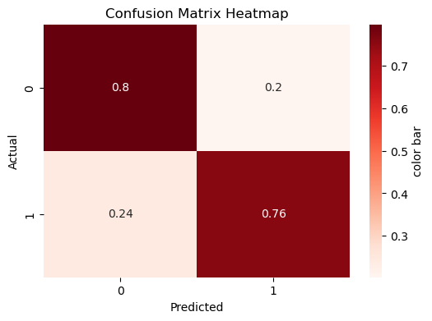
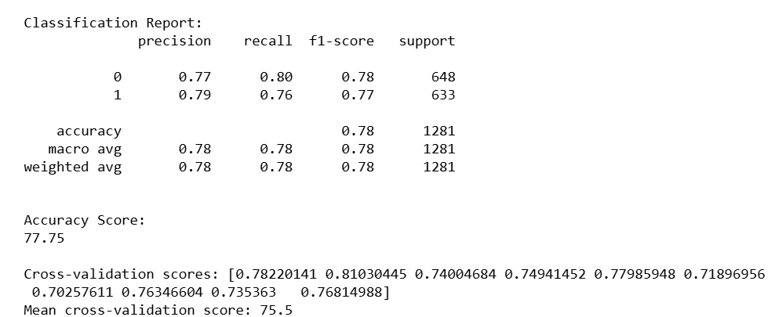
Linear Model – Logistic Regression
Logistic regression (LR) is a linear model that is easy to implement and interpret. It is used for the binary classification of categorical dependent variables.
LR model trained on the cleaned and scaled healthcare_dataset gives the following result:
Logistic Regression’s model heatmap

Slide 25
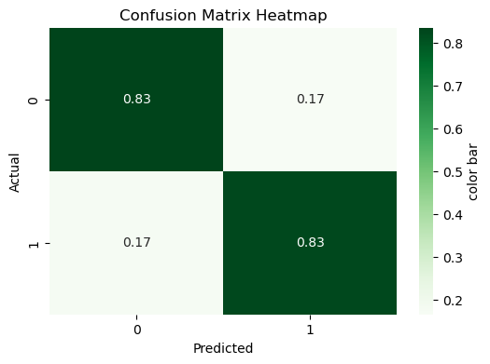
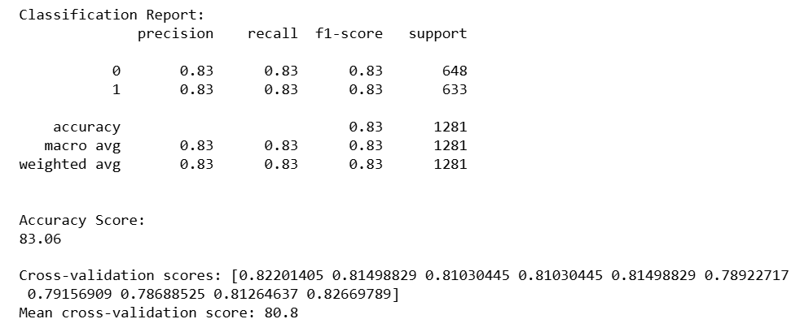
Ensemble model – Random Forest
Random forest (RF) is an ensemble learning method that builds on a large number of decision trees during training and outputs the mode of the classes for a classification problem. It offers, with minimal tuning, a strong, high-accuracy model. It manages big datasets effectively and lowers overfitting by averaging many trees.
RF model trained on the cleaned and scaled healthcare_dataset gives the following result:
Random Frorest’s model heatmap

Slide 26

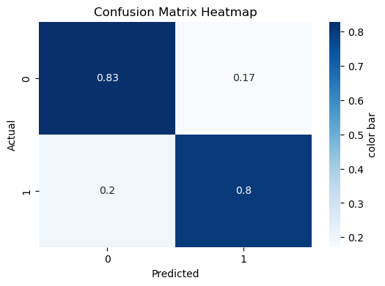
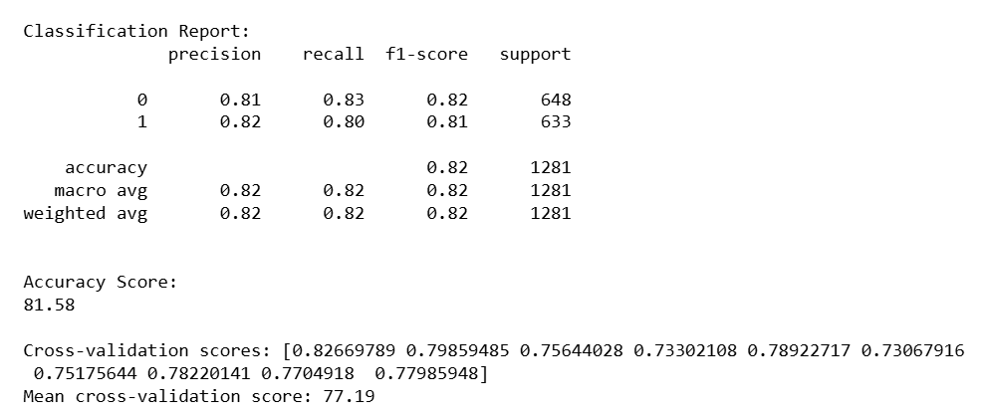
Boosting Model – Extreme Gradient Boosting (XGBoost)
XGBoost is a type of gradient boosting model which uses gradient descent to minimize the loss function. It is a distributed gradient-boosting library that is optimized for efficiency, flexibility, and portability. It is a more regularized version of gradient boosting that avoids overfitting.
XGBoost model trained on the cleaned and scaled healthcare_dataset gives the following result:
XGBoost’s model heatmap

Slide 27
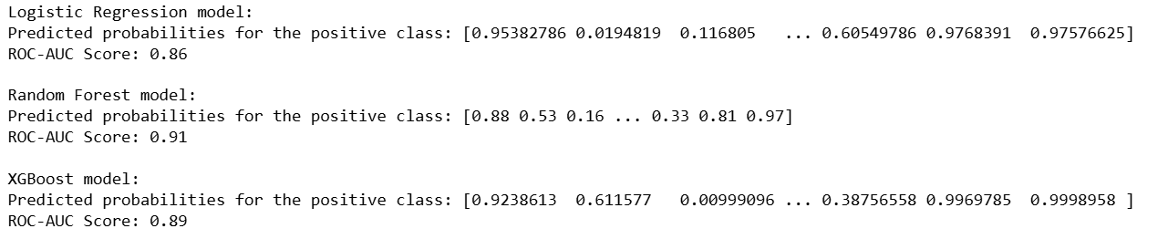
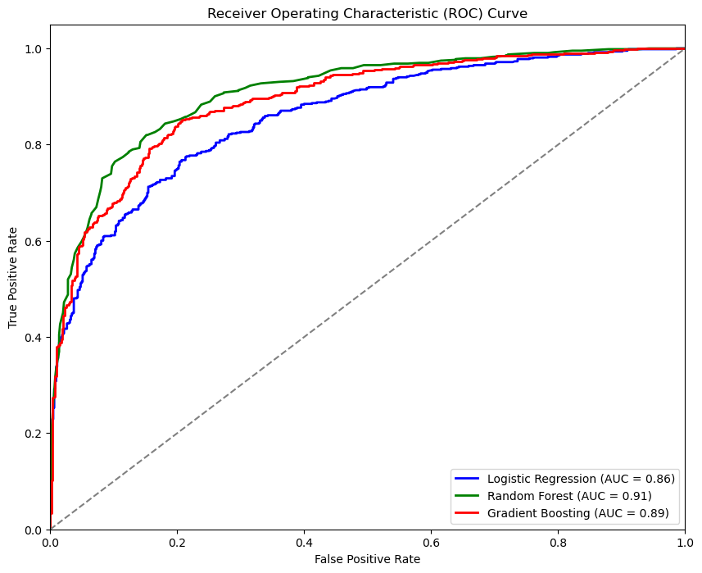
AUC-ROC For the models
Logistic Regression shows a ROC-AUC score of 0.86 which indicates good class distinction, and a broad range of projected probabilities indicates confidence in predictions.
Gradient boosting also shows a ROC-AUC score of 0.89 which depicts excellent class distinction, and a broad range of projected probabilities indicates high prediction confidence.
The Random Forest model shows the best performance with a 0.91 ROC-AUC score, suggesting a very high-class distinction. The predicted probabilities are cautious, avoiding extreme values
ROC Curve for LR, RF, and XGBOOST’ models

Slide 28
Best model
Random Forest outperformed the other two models and is considered more suitable for the prediction of drug persistency among patients due to its high accuracy, F1-score and AUC-ROC score, with a good balance between precision and recall, indicating it is reliable in both identifying positive cases and avoiding false positives. Random Forest model is therefore considered the best model, followed by XGBoost and Logistic Regression.

Slide 29
Thank You

